Slide 1
Graph Neural Network
In
Computer Vision

Slide 2
What is even Graph Neural Network?

Slide 3
Euclidean Data

Slide 4
Non-Euclidean Data

Slide 5
Why not use CNN with grahs?

Slide 6
When to use Graph Neural Network

Slide 7
Node Classification
?
?
?

Slide 8
Node Classification

Slide 9
Link Prediction

Slide 10
Graph Classification

Slide 11
Community Detection

Slide 12
Anomaly Detection

Slide 13
How does Graph Neural Network work
How to perform a forward pass

Slide 14
Example Graph
1
2
4
3

Slide 15

Adjacency Matrix ($A$)
1
2
4
3
 | 1 | 2 | 3 | 4
1 | 0 | 1 | 0 | 0
2 | 1 | 0 | 1 | 1
3 | 0 | 1 | 0 | 1
4 | 0 | 1 | 1 | 0

Slide 16
Include Self
1
2
4
3

Slide 17

Adjacency Matrix, including self ($\hat{A}$)
1
2
4
3
 | 1 | 2 | 3 | 4
1 | 1 | 1 | 0 | 0
2 | 1 | 1 | 1 | 1
3 | 0 | 1 | 1 | 1
4 | 0 | 1 | 1 | 1

Slide 18

Node Feature Matrix ($X$)
1
2
4
3
1 | 1
2 | 2
3 | 3
4 | 4

Slide 19

Degree Matrix, including self ($\hat{D}$)
1
2
4
3
$$\hat{A}$$
 | 1 | 2 | 3 | 4
1 | 1 | 1 | 0 | 0
2 | 1 | 1 | 1 | 1
3 | 0 | 1 | 1 | 1
4 | 0 | 1 | 1 | 1
 | 1 | 2 | 3 | 4
1 | 3 | 0 | 0 | 0
2 | 0 | 5 | 0 | 0
3 | 0 | 0 | 4 | 0
4 | 0 | 0 | 0 | 4

Slide 20
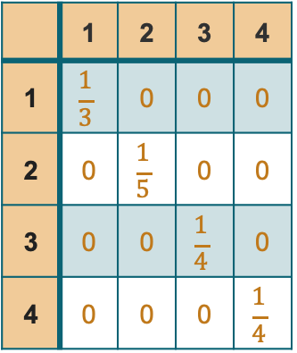

Inverse Degree Matrix ($\hat{D^{−1}}$)
1
2
4
3
$$\hat{D}$$
 | 1 | 2 | 3 | 4
1 | 3 | 0 | 0 | 0
2 | 0 | 5 | 0 | 0
3 | 0 | 0 | 4 | 0
4 | 0 | 0 | 0 | 4
 | 1 | 2 | 3 | 4
1 | $$\frac{1}{3}$$ | 0 | 0 | 0
2 | 0 | $$\frac{1}{5}$$ | 0 | 0
3 | 0 | 0 | $$\frac{1}{4}$$ | 0
4 | 0 | 0 | 0 | $$\frac{1}{4}$$

Slide 21
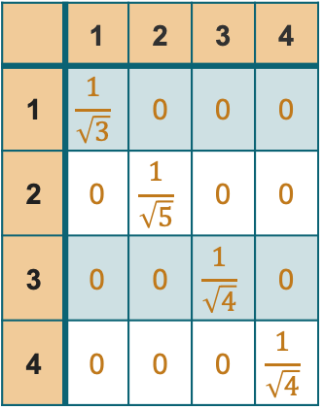

Inverse Degree Matrix ($\hat{D^{−\frac{1}{2}}}$)
1
2
4
3
$$\hat{D}$$
 | 1 | 2 | 3 | 4
1 | 3 | 0 | 0 | 0
2 | 0 | 5 | 0 | 0
3 | 0 | 0 | 4 | 0
4 | 0 | 0 | 0 | 4
 | 1 | 2 | 3 | 4
1 | $$\frac{1}{\sqrt{3}}$$ | 0 | 0 | 0
2 | 0 | $$\frac{1}{\sqrt{5}}$$ | 0 | 0
3 | 0 | 0 | $$\frac{1}{\sqrt{4}}$$ | 0
4 | 0 | 0 | 0 | $$\frac{1}{\sqrt{4}}$$

Slide 22

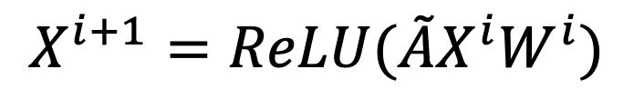
Forward Pass in Graph Convolution Network
$$X^{i+1}=ReLU(\tilde{A}X^{i}W^{i})$$
$$\tilde{A}= {\hat{D}}^{−\frac{1}{2}}\hat{A}{\hat{D}}^{−\frac{1}{2}}$$

Slide 23
Sources
Pham, Chau. “Graph Convolutional Networks (GCN) | by Chau Pham | Artificial ... - Medium.” Graph Convolutional Networks (GCN), July 20, 2020. https://ai.plainenglish.io/graph-convolutional-networks-gcn-baf337d5cb6b.
“Papers with Code - GCN Explained.” GCN Explained | Papers With Code. Accessed October 18, 2022. https://paperswithcode.com/method/gcn.
“Graph Neural Networks with PYG on Node Classification, Link Prediction ...” Graph Neural Networks with PyG on Node Classification, Link Prediction, and Anomaly Detection. Accessed October 25, 2022. https://towardsdatascience.com/graph-neural-networks-with-pyg-on-node-classification-link-prediction-and-anomaly-detection-14aa38fe1275.

